Slide 1
Qualities of Software

Slide 2
Quality Aspects (Contd.)
Reusability
Portability
  Can it run in different environments?
Understandability
  For the tasks of inherently similar difficulty is the software system easy to understand?
Interoperability
  Ability to coexist and cooperate with other systems
Security
  Ability to keep information safe; ability to avoid intrusions; low number of vulnerabilities
  Integrity, Confidentiality?

Slide 3
Example of Control Structures and Understandability
Control skips around among the program’s statements
    benefit = minimum;
    if (age < 75) goto A;//may be a function call
    benefit = maximum;
    goto C;
    if (AGE < 65) goto B;
    if (AGE < 55) goto C;
    A: if (AGE < 65) goto B;
    benefit = benefit * 1.5 + bonus;
    goto C;
    B: if (age < 55) goto C;
    benefit = benefit * 1.5;
    C: next statement
Rearrange the code
      if (age < 55) benefit = minimum;
      elseif (AGE < 65) benefit = minimum + bonus;
      elseif (AGE < 75) benefit = minimum * 1.5 + bonus;
      else benefit = maximum;
Restructuring

Slide 4
Quality Aspects (Contd.)
Productivity
  Amount of work done by a software team in a unit time
  Efficiency of the process
Timeliness
  Ability to deliver a product on time
Visibility
  Have all steps of the process and their current status been clearly documented?

Slide 5
Quality Models

Slide 6
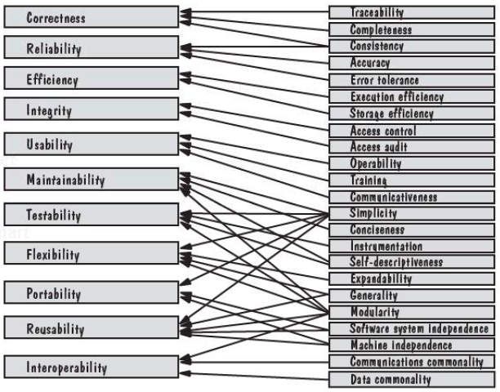
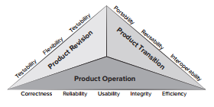
McCall’s Quality Model
Software Product Aspects
  Operation characteristics
  Ability to undergo change
  Adaptability to new environments
See Chapter 15 of 9th Edition of Pressman’s Book

Slide 7
FURPS by HP
Functionality
Usability
Reliability
Performance
Supportability
  Ease with which a system can be installed, its problems can be localized
  Maintainability?

Slide 8
ISO 25010 Quality Model
v1 in 2011, v2 in 2017
Quality in Use
  Characteristics appropriate when using software in a particular context
Product Quality
  Characteristics focusing on static and dynamic nature of the software system
See Chapter 15 of 9th Edition of Pressman’s Book

Slide 9
Software Application Domains

Slide 10
Software Application Domains
Broad categories of software
  System software: programs written to service other programs e.g. compiler, editor, operating system components
  Application software: stand-alone programs to solve a specific business need e.g. Information systems like leave management system, point of sales system
  Engineering/Scientific software: programs that can simulate things like astronomy, volcanology, molecular biology etc.
  Real-time Systems: must respond to events within a predefined and strict period of time. Quantitatively specifiable and verifiable notion of response time. Response time as correctness?

Slide 11
Software Application Domains
Broad categories of software (Contd.)
  Embedded systems: resides within a product or system and performs special functions for user as well as for itself e.g. system to measure temperature in a control shed, keypad control in a microwave oven
  Product-line software: software for a group of related products marketed under a single brand name e.g. MS Office has MS Word, PowerPoint, Excel etc.
  Web/Mobile applications: browser based and mobile device-based apps
  Artificial intelligence software: makes use of heuristics-based algorithms to solve complex problems e.g. robotics software, expert systems to diagnose a disease, forecasting system

Slide 12
Legacy Software
Old systems
  Continually modified to meet changes (requirements, platforms)
  Difficult and costly to change further
    Inextensible designs
    Convoluted code
    Poor or nonexistent documentation
    Unarchived results of test cases
    Poorly managed change history
  Risky to evolve
    Perform core functions
    Indispensable to business

Slide 13
Software Application Domains and Quality
Domain | System Characteristics | Most Relevant Quality Characteristics
Information Systems | Data oriented. Storage and retrieval of data. E.g. banking systems, library systems, HRM systems etc. | Data integrity, Security, Data availability, Transaction performance
Real-time Systems | Control/Event oriented. Respond to events in predefined and strict period of time. Sensors based. E.g. flight control software, automatic fault detection in a factory environment, surveillance systems etc. | Correctness (response time), Reliability, Safety (-ve requirements)
Distributed Systems | Computers connected through a communication network. E.g. distributed file systems | Portability, Interoperability, Performance, Reliability
Embedded Systems | Hardware specific. Software interfaces with other system components. E.g. software inside ovens, dishwashers etc. | Efficiency, Robustness,
Quality characteristics related to human-computer aspects are relevant in all cases

Slide 14
Class Activity
List the relevant quality aspects:
You have n unique non-negative integers stored in an array. You need to sort these elements in ascending order.
  Is correctness relevant? How to measure its correctness?
  Is efficiency relevant? How to measure its efficiency?
  Is robustness relevant? How to measure robustness?

Slide 15
Class Activity
List the relevant quality aspects:
Recall the farmers and gardens problem.
  Is correctness relevant? How to measure its correctness?
  Is efficiency relevant? How to measure its efficiency?
  Is robustness relevant? How to measure robustness?
  Is usability relevant? How to measure usability?
  Is maintainability (evolvability) relevant? How to measure evolvability?

Slide 16
Class Activity
List the relevant quality aspects:
Consider a POS system for a small grocery store?
  Is correctness relevant? How to measure its correctness?
  Is efficiency relevant? How to measure its efficiency?
  Is robustness relevant? How to measure robustness?
  Is usability relevant? How to measure usability?
  Is maintainability (evolvability) relevant? How to measure evolvability?
  Is performance relevant? How to measure performance?
  Is reliability relevant? How to measure reliability?
  Is verifiability relevant? How to measure verifiability?

Slide 17
Software Engineering Process
Framework and Umbrella Activities

Slide 18
Process
Is a series of steps involving activities, constraints, and resources to produce an intended output
  Prepare for exams
  Conduct a software competition
  Organize a trip
  Write a term project report
Involves a set of tools and techniques
  Block diagrams
  Notations

Slide 19
Is a process Useful?
Impose consistency and structure on a set of activities
Guide us to understand, control, examine, and improve the activities
Enable us to capture our experiences and pass them along

Slide 20
Framework Activities
Communication
  customer, other stakeholders
Planning
  Roadmap, project plan
Modeling
  Understanding requirements, provide design
Construction
  Code generation, testing
Deployment
  Delivery to customer, feedback and evaluation

Slide 21
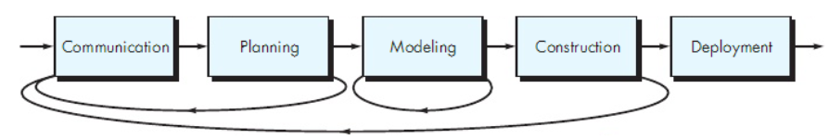
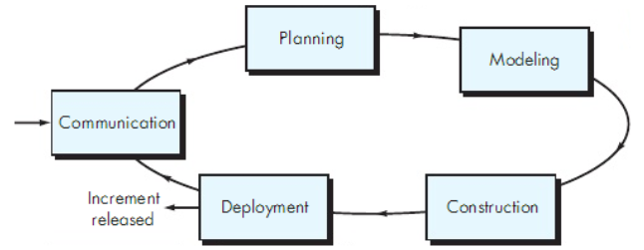
Process Flow

Slide 22
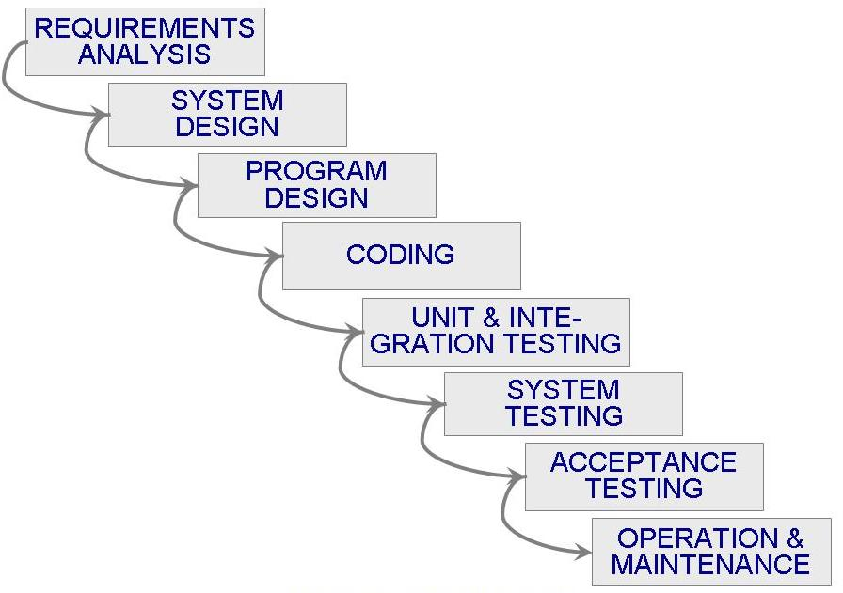
Waterfall

Slide 23
Software Lifecycle
When a process involves building a software (product), the process may be referred to as software (product) lifecycle
  Requirements analysis and definition
  System (architecture) design
  Program (detailed/procedural) design
  Writing programs (coding/implementation)
  Testing: unit, integration, system
  System delivery (deployment)
  Maintenance

Slide 24
Umbrella Activities
TR
Software Quality Assurance
Configuration Management
Technical Reviews
Project Tracking and Control
Risk Management
CM
PTC
SE Process
RM
SQA

Slide 25
Software Engineering Practice
Understand the problem
Plan a solution
Carry out the plan
Examine the results for accuracy

Slide 26
Software Engineering Practice
Understand the problem (communication, analysis)
Plan a solution (modeling and design)
Carry out the plan (code generation)
Examine the results for accuracy (testing and QA)

